Slide 1
Module-6
Emerging Trends in Marketing:
Presentation by
Dr. Basavaraj S.Kudachimath

Slide 2
Discussion Points
Marketing Planning.
Concepts of B2B marketing,
Service Marketing,
Digital and social media Marketing,
Green Marketing,
Event Marketing,
Marketing Audit,
Sponsorship Marketing
Cause Related Marketing,
Marketing for Non-Profit Organizations,
Relationship marketing,
Marketing Strategies for Leaders, Challengers, Followers and Startups.
Social Responsibility of marketing,
Neuro Marketing,
Sensory Marketing,
societal marketing concept,
Premiumization.

Slide 3
Marketing Planning
Marketing planning consists of the policies, programs, budgets, marketing mix, historical data, current market position and future predictions of the business. However, a good marketing plan also requires a solid marketing strategy as without a proper marketing strategy marketing plan cannot become useful for the business.

Slide 4
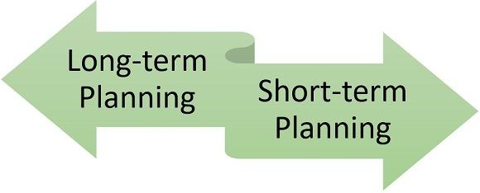
Types of Marketing Plan
1. Long -Term Marketing Planning
The planning made to achieve the long-term goals of an organization is known as long-term marketing planning. It involves deep research of the market conditions and thus handled by the top-level management of the organization. It is based on the precise strategies set up by the entrepreneurs, considering all the future possibilities and risk factors.
2. Short –Term Marketing Planning
Such planning is done for a short period of time, i.e., for less than one year, for meeting the recurring problems of the business and does not require high-level efficiency. Thus, it is made by the middle-level management of the organization.

Slide 5
Steps in Marketing Planning
Analysis of marketing situation
Developing marketing objectives
Formulation of marketing strategies
Preparing action programmes & budgets
Developing control procedure

Slide 6
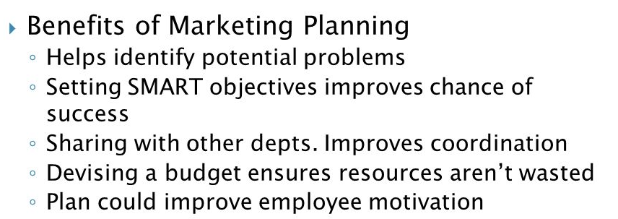

Slide 7
Concept of B2B marketing
B2B marketing means business-to-business marketing. It's any marketing strategy or content used by one business to target and sell to another business. For instance, companies that sell services, products, or SaaS (software-as-a-service) to other companies or organizations typically use B2B marketing.

Slide 8
Characteristics of B2B marketing
B2B Markets are More Complex. ...
B2B Buyers are More Rational and Demanding. ...
Typically B2B Products Are More Complex, But Buyers Are More Informed. ...
Limited Number of Purchasing Units in B2B Markets. ...
B2B Markets Consist of Needs-Based Segments.

Slide 9
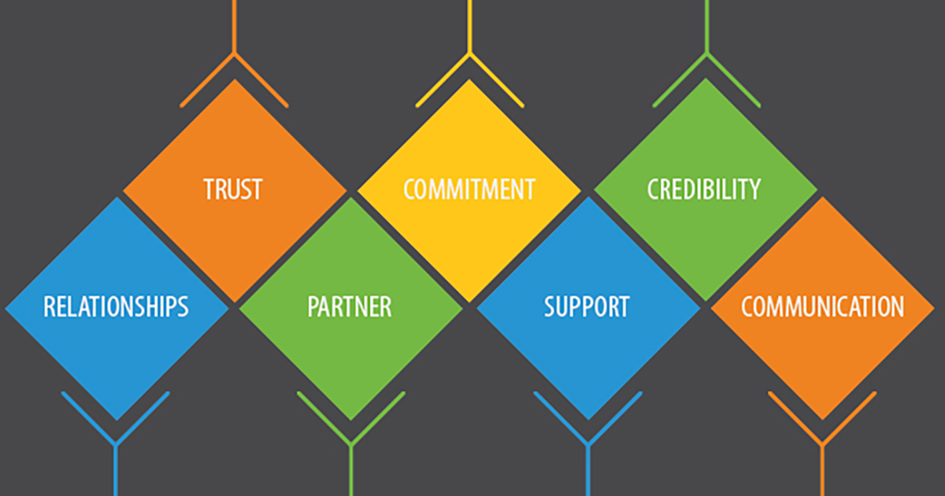
THE SEVEN KEY CONCEPTS OF B2B MARKETING

Slide 10
B2B marketing Vs Consumer Marketing
Sl No | BUSINESS MARKET | CONSUMER MARKET
1 | Small number of BMs | Large Markets
2 | BMs have larger purchasing power and buy in quantity | CM is a smaller purchasing power and buy
3 | BMs are concentrated | CMs are not (Fragmented)
4 | Sellers deal direct with business users | More levels (More number of Intermediaries)
5 | BMs are usually regionally concentrated | Located in many locations
6 | BMs can be vertically or horizontally concentrated | Not the case with CMs
7 | BM’s buying motives are rational and purchase is methodical and objective. | Its not rational, its instinct, and not objective.

Slide 11
Services Marketing
Services marketing is a form of marketing businesses that provide a service to their customers use to increase brand awareness and sales. Unlike product marketing, services marketing focuses on advertising intangible transactions that provide value to customers.
Examples of services marketing organizations
Financial Services: Banks, Insurance companies, Stock exchange companies.
Education Services: Schools, Colleges, training institutes
Entertainment Services: Amusement parks, cinema halls, etc
Medical Services: Hospitals, diagnostic centers etc
Tours and Travel : Transportation companies, Package tour organaizers etc

Slide 12
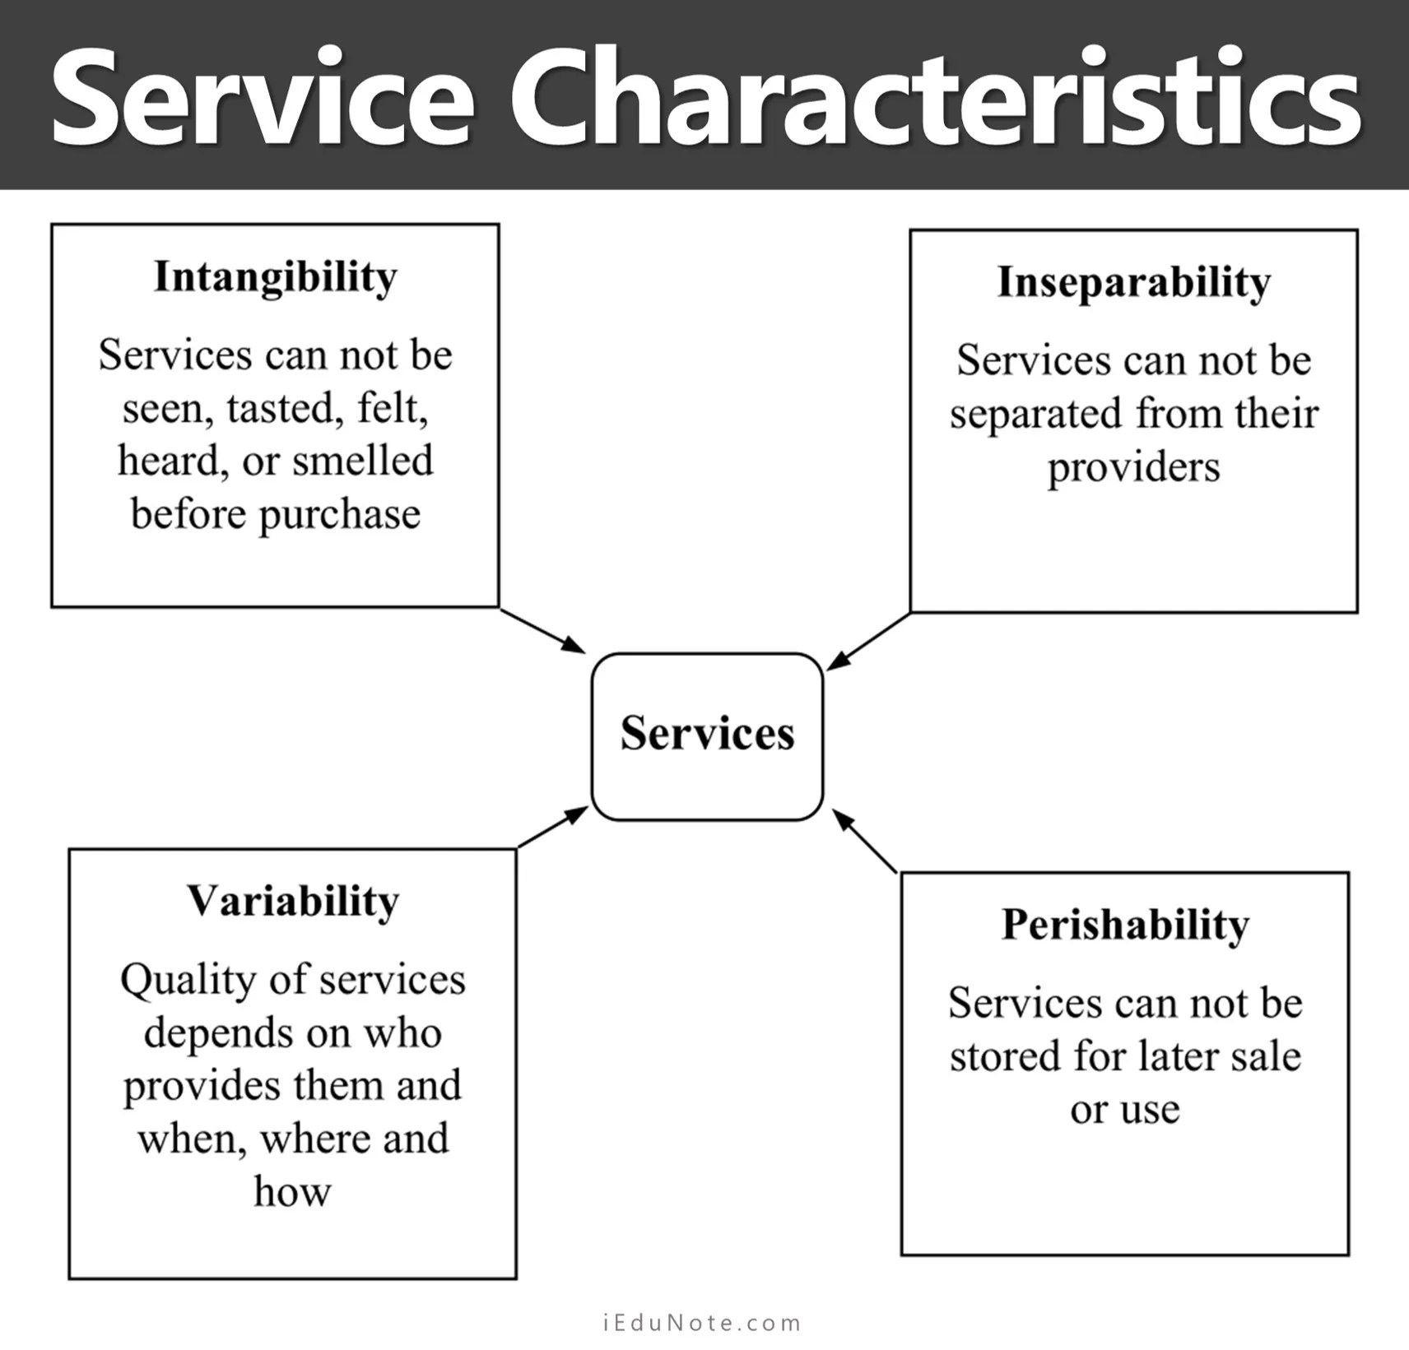

Slide 13
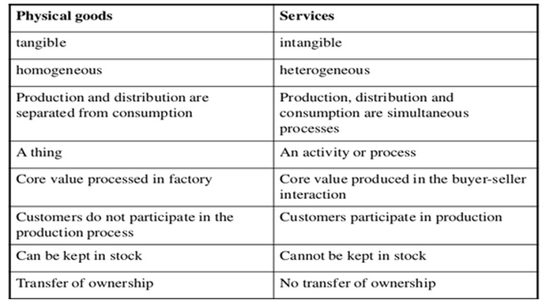
Difference between goods and services marketing

Slide 14
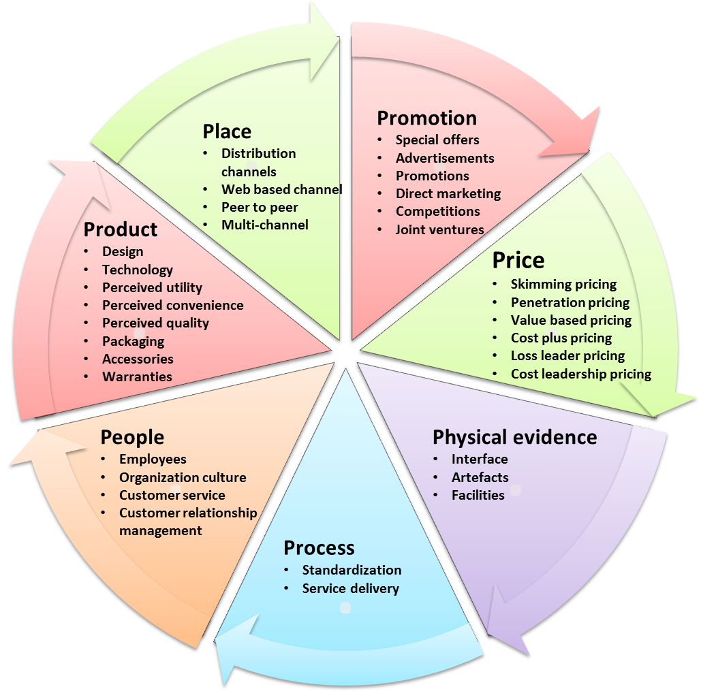
7 Ps of Services Marketing Mix

Slide 15
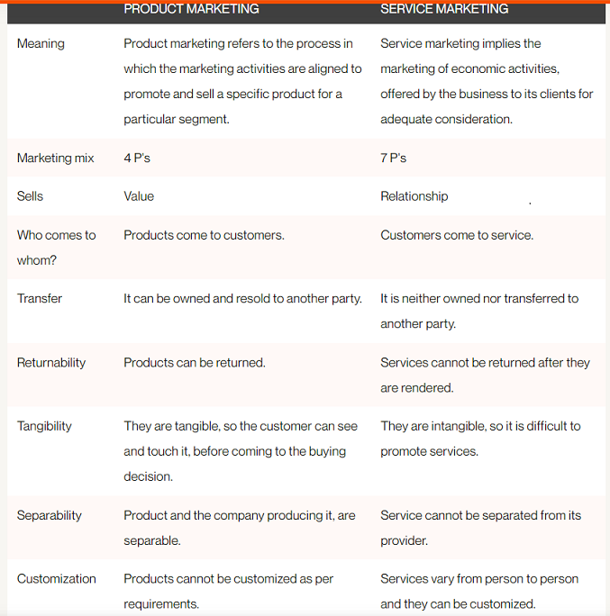

Slide 16
Digital Marketing
Any marketing that uses electronic devices and can be used by marketing specialists to convey promotional messaging and measure its impact through your customer journey. In practice, digital marketing typically refers to marketing campaigns that appear on a computer, phone, tablet, or other device. It can take many forms, including online video, display ads, search engine marketing, paid social ads and social media posts. Digital marketing is often compared to “traditional marketing” such as magazine ads, billboards, and direct mail. Oddly, television is usually lumped in with traditional marketing.

Slide 17
Social Media Marketing
Social media marketing means driving traffic and brand awareness by engaging people in discussion online. You can use social media marketing to highlight your brand, products, services, culture, and more. With billions of people spending their time engaging on social media platforms, focusing on social media marketing can be worthwhile.
The most popular digital platforms for social media marketing are Facebook, Twitter, and Instagram, with LinkedIn and YouTube

Slide 18
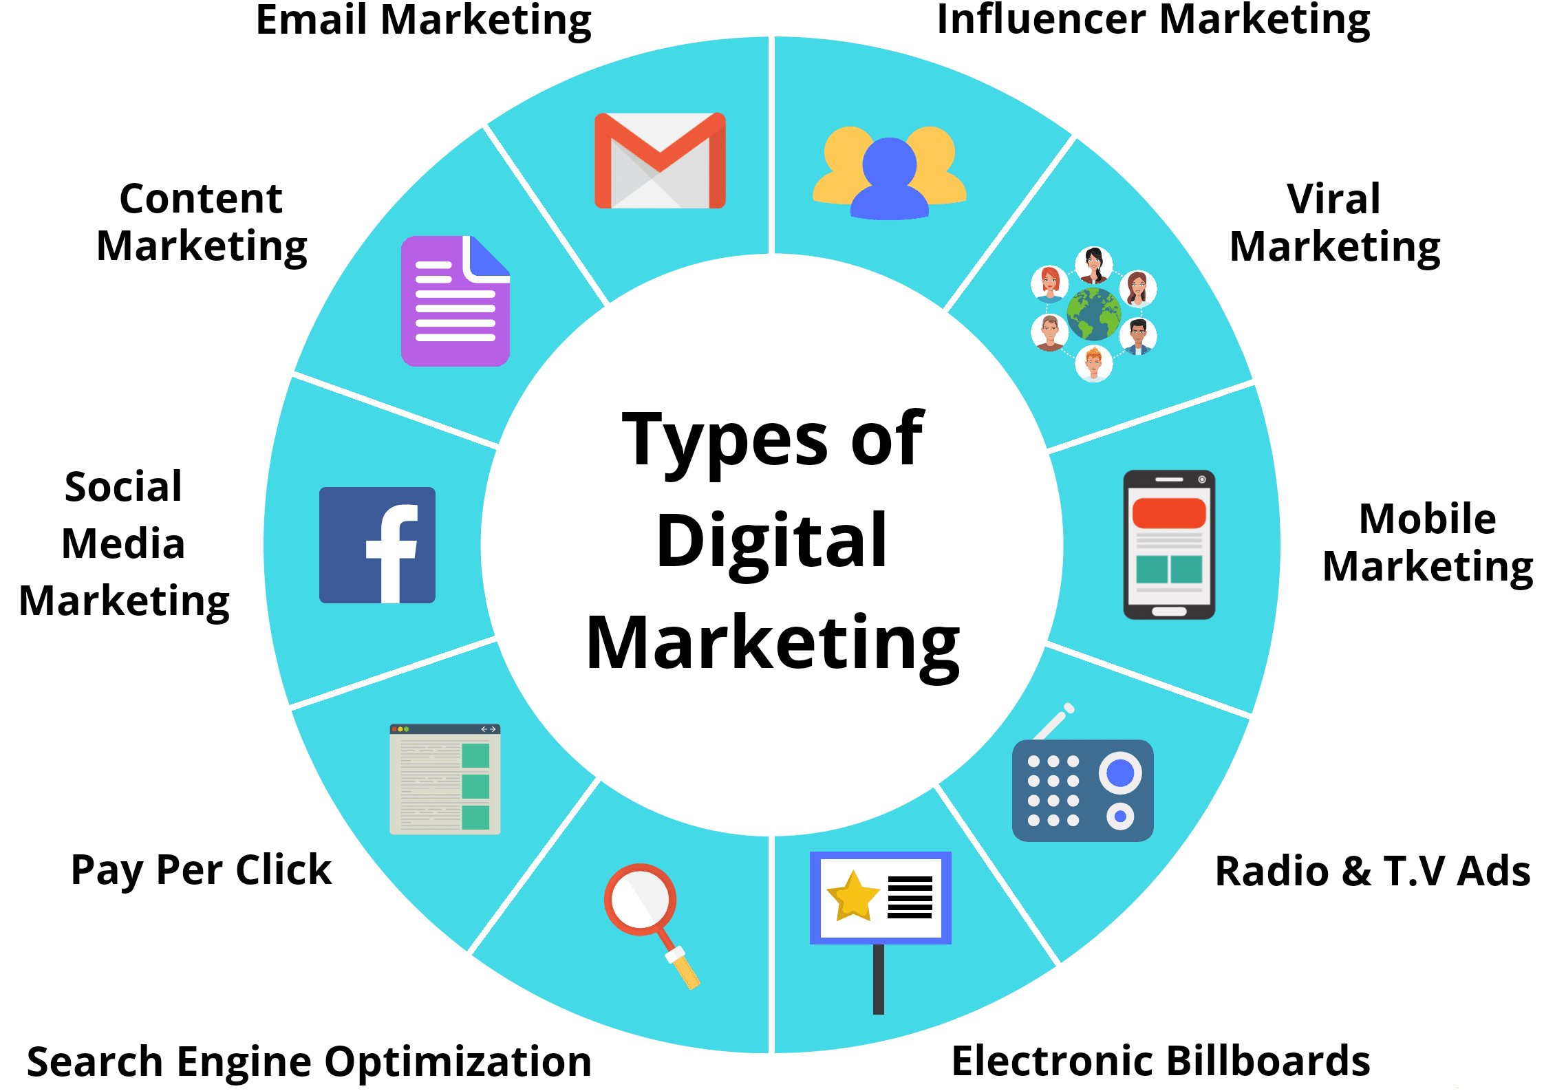

Slide 19
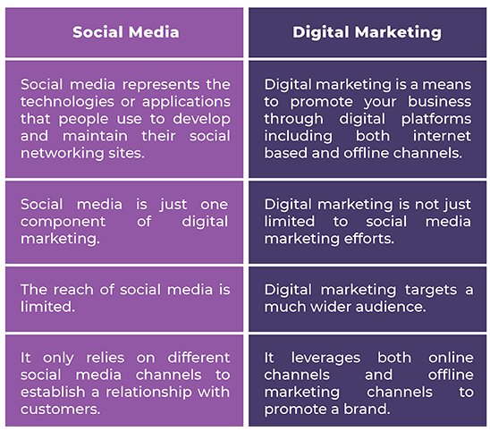
Differences between social media Vs. Digital media

Slide 20
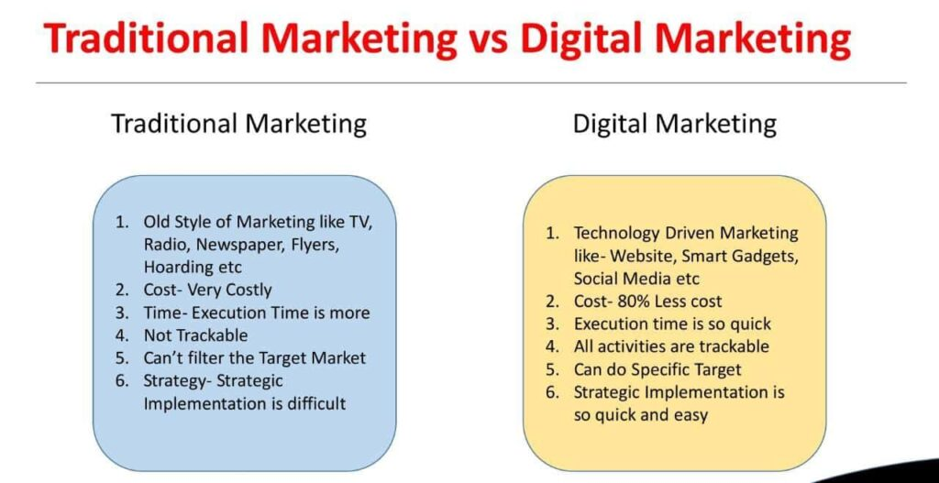

Slide 21
Green Marketing
Green marketing refers to the practice of developing and advertising products based on their real or perceived environmental sustainability.
Examples of green marketing include advertising the reduced emissions associated with a product’s manufacturing process, or the use of post-consumer recycled materials for a product's packaging. Some companies also may market themselves as being environmentally-conscious companies by donating a portion of their sales proceeds to environmental initiatives, such as tree planting.

Slide 22
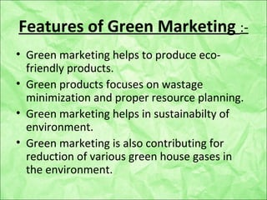

Slide 23


Slide 24
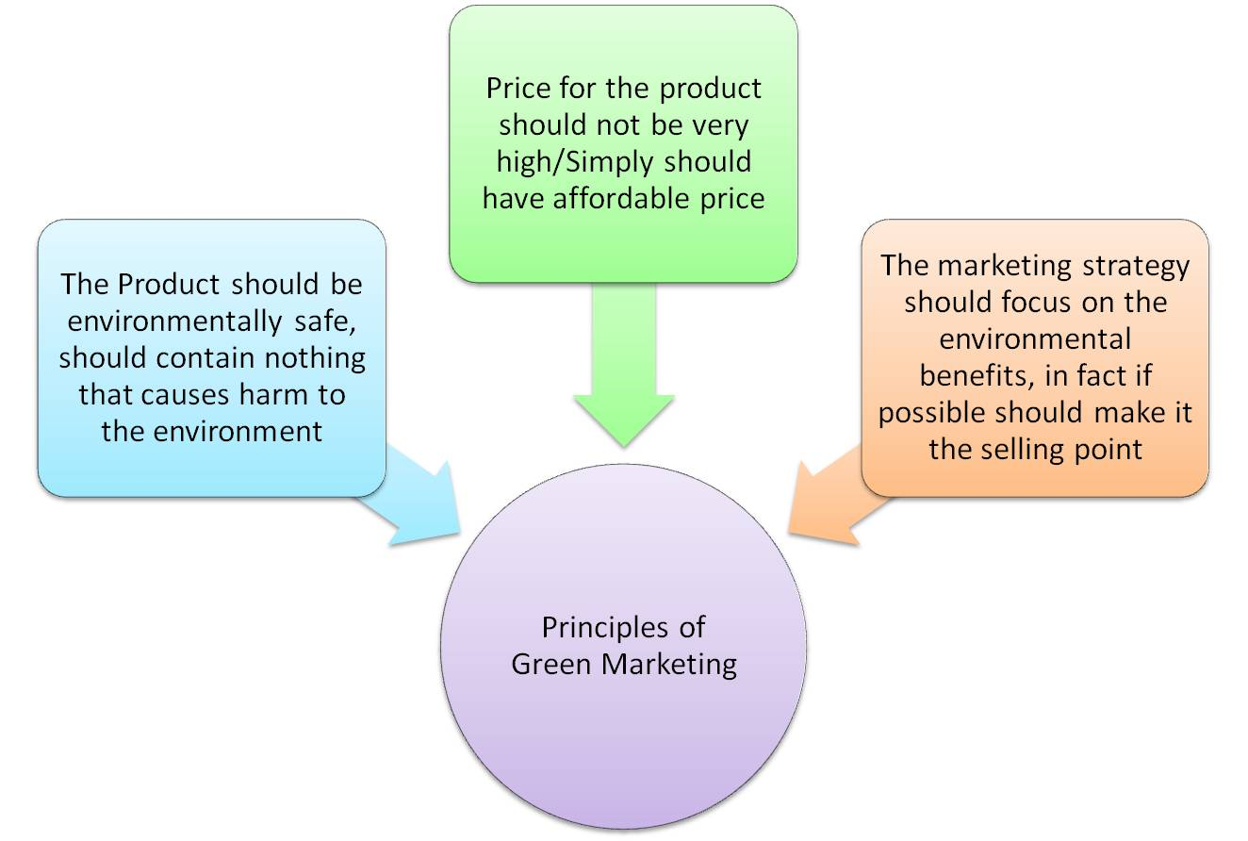

Slide 25
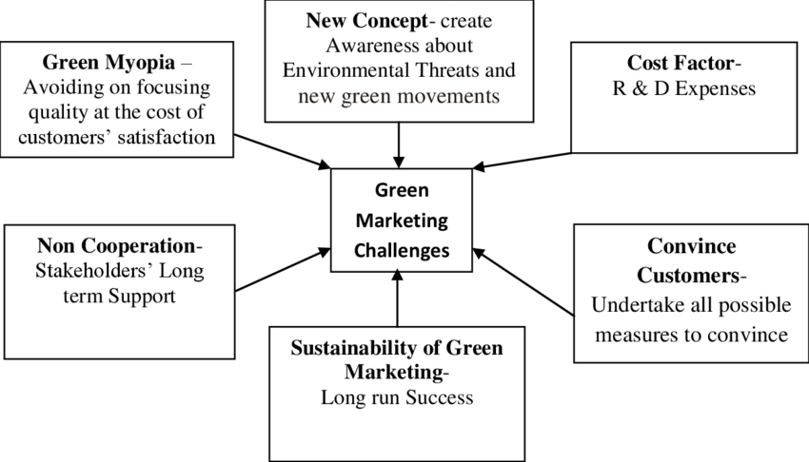

Slide 26
Event Marketing
Event marketing is a strategy marketers use to promote their brand, product, or service with an in-person or real-time engagement.
Events can be online or offline, and companies can participate as hosts, co-hosts, participants or sponsors. Whether online or in-person, event marketing is the ultimate way to connect with audience, showcase brand, and drive results.

Slide 27
Benefits of Event Management trategy
Build brand awareness
Increase customer engagement
Generate leads
Educate prospects and customers
Upsell customers

Slide 28
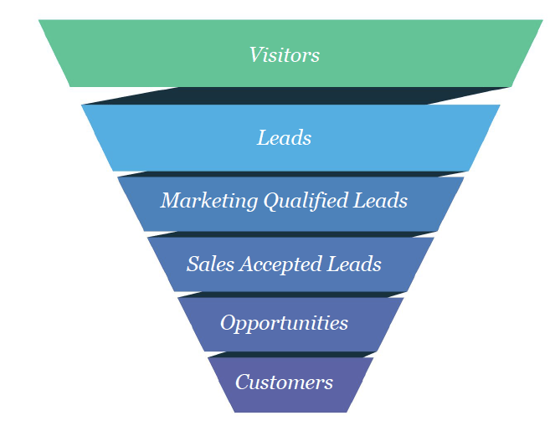
Lead generation process through event management

Slide 29
Marketing Audit
A marketing audit is an assessment that is performed to analyze company’s current marketing strategy from top to bottom. The goal of a marketing audit is to identify the strengths and weaknesses of marketing efforts and to help to devise a plan to improve effectiveness and performance.

Slide 30
Elements of Marketing Audit
SWOT analysis
Market research
Competitor analysis

Slide 31
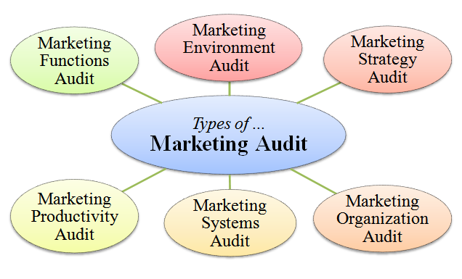

Slide 32
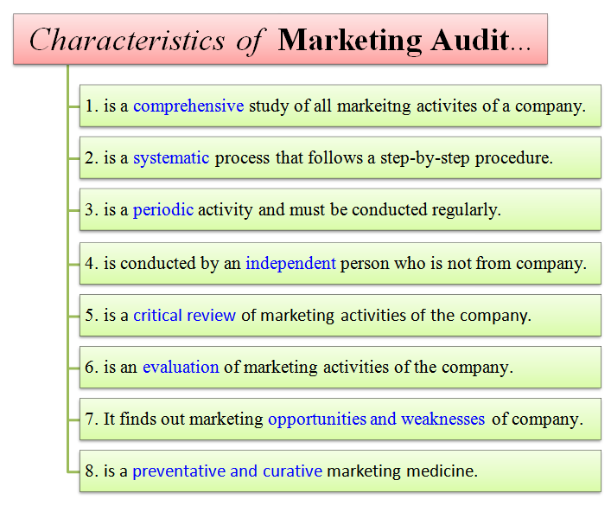

Slide 33
Sponsorship Marketing
Sponsorship marketing is when one brand aligns itself with an aspect of another brand. Often, this will be an event, such as a sports game, a performance or a conference. But brands might also choose to sponsor a TV program, a charity or even a celebrity.
Usually, the sponsor offers support in the form of finance or other resources. In return, the sponsee helps to boost their brand awareness and reputation.

Slide 34
Methods of sponsorship marketing
Cash sponsors: The sponsor gives the sponsee financial support. Big brands such as McDonald’s, Pepsi and Coca-Cola invest billions of pounds in sponsorship every year.
In-kind sponsors: Rather than giving the sponsee cash, the sponsor donates products or services. This could be anything from catering to printing.
Media sponsors: Essentially a form of in-kind sponsorship. Media sponsors promote the sponsee’s activity, perhaps by posting about it on social media, by publishing blog posts or even by broadcasting it on television in the case of large events and sports fixtures.
Promotional partners: Similar to media sponsors, promotional partners are generally individuals who can help to promote the sponsee’s activity – such as bloggers or influencers. They often agree to sponsor events in return for speaking slots.

Slide 35
Advantages of Sponsorship Marketing
For the sponsor
Brand awareness: Sponsorship offers brands the chance to get in front of new (and often, large!) audiences.
Reputation: By aligning themselves with something that their audience really cares about, such as a sports team or TV programme, brands can improve their reputation.
Brand positioning: Brands can use sponsorship to reach specific demographics, in the same way as Red Bull was able to get the attention of a sporting audience by sponsoring sports events and athletes.
For the sponsee
Financing: Sponsorship helps to offset the cost of carrying out the sponsee’s activity, whether it’s holding an event or staging a sports game.
Expertise: In the case of in-kind or media sponsors, the sponsee gets exclusive access to a brand’s network and expertise.
Authority: Getting a household name as a sponsor can help to lend a sponsee’s activity legitimacy.

Slide 36
Disadvantages:
For the sponsor
Hard to measure: Sponsorship marketing can be hard to track and measure, particularly when activities take place offline.
Passive: Usually, sponsorship is fairly passive, without many opportunities to give audiences a CTA. This makes it better suited to gaining brand awareness than hitting sales targets.
In high demand: The biggest sponsorship opportunities can be competitive, making them hard (and expensive!) to access. However, don’t underestimate the power of sponsorship in smaller, less competitive niches, such as local opportunities.
For the sponsee
Balancing needs: Sponsees can find it hard to cater to the needs of both the sponsor and the audience. For example, a sponsor may want airtime, but the audience may not enjoy having to listen to an hour-long pitch!

Slide 37
Cause related marketing:
Cause marketing involves a collaboration between a for-profit business and a nonprofit organization for a common benefit. Cause marketing can also refer to social or charitable campaigns put on by for-profit brands. Typically, a brand's association with a nonprofit will boost their corporate social responsibility.
Example: Infosys ltd doing social activities through Infosys foundation.

Slide 38
Types of Cause related marketing
Incentives
Such cause marketing campaigns encourage customers to donate to a cause by offering them incentives in the form of discounts, gift coupons or free products.
Point-Of-Sale Campaign
This type of cause marketing is most commonly used by retailers and involves soliciting donations from customers during checkout when they make a purchase.
Buy One, Give One
In this type of cause marketing, organizations donate a product to a needy person when a customer purchases something from their brand.

Slide 39
Benefits of cause related marketing
Cause Marketing Helps An Organization Improve Brand Image And Reputation Through Positive Media Coverage, Word-Of-Mouth Recommendations And Good Customer Reviews
Cause Marketing Portrays A Brand As Purpose-Driven, Giving It A Significant Edge Over Its Competitors In The Market
When Employees Find Meaning In Their Work And Can Contribute To The Betterment Of Society Through Cause Marketing, Their Job Satisfaction Increases And Employee Turnover Reduces

Slide 40
Marketing for Non-profit Organaization
What are Non Profit Organizations?
Not-for-Profit Organizations are the establishments that are for utilized for the welfare of the community and are set up as charitable associations which operate without any motive for profit. Their primary objective is to provide service to a specific class or the public at the larger picture.
Examples: Schools, colleges, hospitals, temples,

Slide 41
Difference between NPO & PO

Slide 42
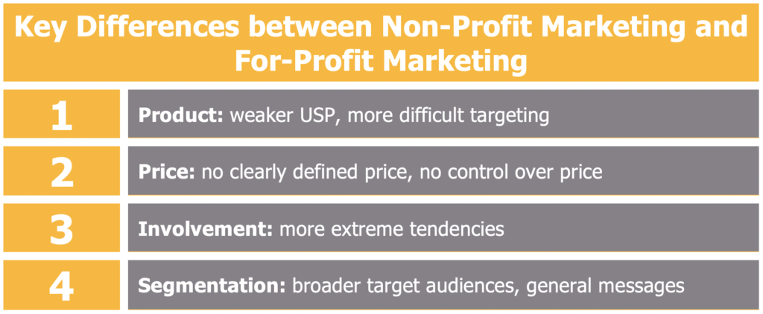

Slide 43
Relationship Marketing
Relationship Marketing is a strategy of Customer Relationship Management (CRM) that emphasizes customer retention, satisfaction, and lifetime customer value. Its purpose is to market to current customers versus new customer acquisition through sales and advertising.
Relationship marketing is a distinct strategy for creating more meaningful customer relationships with the goal of ensuring satisfaction with your business and what you offer, and creating brand loyalty, retention, and a boost in customer lifetime value.
Relationship marketing is also known as “building a buyer journey” or “personalized marketing strategies,” as it focuses on building revenue through healthier client relationships.
Examples: Starbucks, Southwest Airlines, Nike, Sendoso and HubSpot. They show how strong customer connections may lead to brand loyalty, repeat purchases, word-of-mouth promotion or social proof.

Slide 44
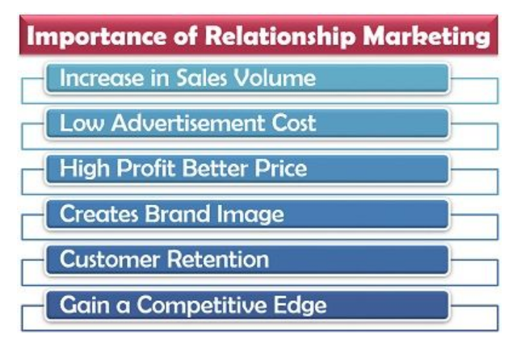

Slide 45
Advantages of RM
Cost-Effective
Increase Customer Retention
Improve Your Marketing ROI
Increase Sales
Lead to Referrals and Higher Brand Awareness
Boost You Above the Competition

Slide 46
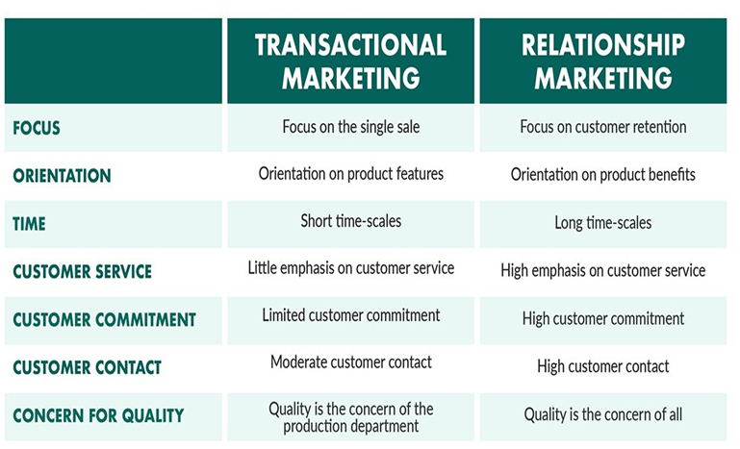
Differentiate between TM V/S RM

Slide 47
Marketing Strategies for Leaders
Who is Market Leader?:
A market leader could be a product, brand, company, organisation, group name which has the highest percentage of total sales revenue of a particular market. Market leader dominates the market by influencing the customer loyalty towards it, distribution, pricing, etc.Example of Market Leader:
In car market in India: Maruti, TATA ,Hyundai, KIA etc
In Chocolate Market: Cadbury
In Beverages: Cococola, Pepsi

Slide 48
Marketing Strategies of Market Leaders
Market Leaders adopt three broad strategies of marketing
1. Expand Market
2. Defend Market share
3. Expand Market share

Slide 49
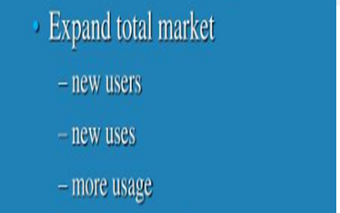
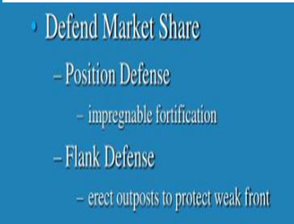
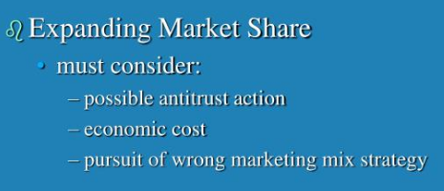
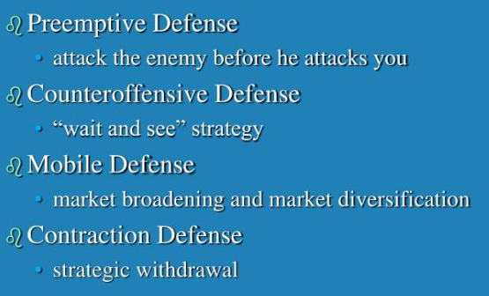

Slide 50
Market strategies for challengers
Who are market challengers?
A market challenger is a firm that has a market share below that of the market leader, but enough of a presence that it can exert upward pressure in its effort to gain more control. Market challengers are able to jockey for industry leadership in several ways:
Example: Pepsi is the market challenger for Cocacola

Slide 51
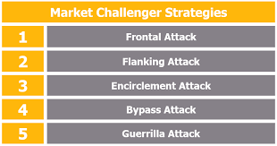

Slide 52
Frontal Attack: The frontal attack is the direct attack, wherein the market challenger matches with the competitor’s product, price, advertising, and promotion activities.
Example: Amul adopted this strategy when it launched Amul Kool and Amul Masti Dahi at a low price with the same level of the quality as that of other competitors in the market.
Flank Attack: The flank attack means, attacking the competitor on its weak points. Here the market challenger determines the weak areas of the competitor in terms of two strategic dimensions i.e. Geographic and segmental.
Example: L.G has successfully made use of this strategy by introducing the color tv “ Sampoorna” for the rural people and outshine the other colored TV players who had a less focus on these areas.
Encirclement Attack: The encirclement attack means, attacking the market leader or a competitor from all the fronts simultaneously, it is the combination of both the frontal and the flank attack.
Example: The FMCG industry applies this attack more aggressively with the intention to outshine the other. ITC and HUL could be the best examples.
Bypass Attack: The bypass attack is the indirect attack, wherein the market challenger does not attack the leader directly, but broaden its market share by attacking the easier markets.
Example: Pepsi adopted this strategy when it launched its mineral water brand “Aquafina” very well before the Coca Cola’s mineral water brand.
Guerrilla Warfare: The Guerrilla warfare is the intermittent attacks imposed by the challenger to demoralize the competitor by adopting both the conventional and unconventional means of attack.
Example: The Pepsi and Coca-Cola follow this strategy aggressively with the intention to harass each other.When the Coca-cola was the official partner of the world cup, the Pepsi counter-attacked it by using the punch line “ Nothing official about it”.

Slide 53
Market followers
Who is market challenger?
A company holding a major market share and competing vigorously with the market leader for outright leadership.
A company that is not the leading company in a particular market but that chooses to keep its position rather than competing in a forceful way to increase its share of the market: Market followers must know how to hold current customers. Market followers must know how to hold current customers.
Example: Panasonic rarely innovates new products. Instead, rather copied Sony’s new products, and then selling them at lower prices. Panasonic earns higher profits than Sony because they did not have to bear the cost of innovation and education. Sony looks at Panasonic as bitter enemies.

Slide 54
Strategies adopted by market followers.
Duffer – Duffer duplicates products and packaging leaders and selling them on the black market or through disreputable dealers.
Cloner – Cloner mimics products, distribution, advertising, and other segments of the leader. Product and packaging Cloner similar to those of the leaders, but the name brand products are somewhat different, such as “Choco-Cola” instead of “Coca-Cola”.
Imitator – Imitator copies leaders in some elements, but keeps diversity in terms of packaging, advertising, pricing, and so on.
Adapter – The adapter takes produce leaders and adapts them, or better. The adapter can choose to sell them in different markets in order to avoid direct confrontation with the leader.

Slide 55
Marketing Strategy for start ups
What is start up company.
A new company trying to establish its new business in the competitive market.
Strategies:
Send Emails
Start A Blog
Post On Social Media
Use Paid Search Advertising (AdWords and Bing Ads are two of the leading paid search networks)
Sponsor An Event

Slide 56
Socially responsible marketing
Socially responsible marketing is a marketing philosophy, that a company should take into consideration, "What is in the best interest of society in the present and long term.
The concept of social responsibility holds that businesses should be good citizens, balancing their money- making operations with activities that benefit society, be it on a local, national, or global scale.
Social responsibility in marketing involves focusing efforts on attracting consumers who want to make a positive difference with their purchases.
Many companies have adopted socially responsible elements in their marketing strategies as a means to help a community via beneficial services and products.

Slide 57
Corporate Social Responsibility/ Social Responsibility of marketing
Corporate social responsibility (CSR) is a self-regulating business model that helps a company be socially accountable—to itself, its stakeholders, and the public.
By practicing corporate social responsibility, also called corporate citizenship, companies can be conscious of the kind of impact they are having on all aspects of society, including economic, social, and environmental.
Advantages: Improves the image of a business, Aids draw in as well as preserve potential workers, You get into the good publications of regulatory authorities, Draws in new financiers, An all new means to advertise your brand name.
Disadvantages: It needs greater prices and expenses, It can enhance investor’s resistance, Shift in the profit-making goal, Client can become impatient, etc,.

Slide 58
EXAMPLES OF CSR
Johnson & Johnson -Their initiatives range from leveraging the power of the wind to providing safe water to communities around the world.
Tata Group: Aarogya, Vidyadhanam, Kaushalya, Vasundhara (Envt.), Amrutdhara, etc….
Ford Motor Company - Ford plans to reduce their greenhouse gas emissions using their Eco Boost engine to increase fuel efficiency.
Bosch - Half of Bosch’s research and development budget is invested in creating environmental protection technology.
LEGO - Lego will invest $150 million over the next 15 years with a focus on addressing climate change and reducing waste.

Slide 59
Neuro Marketing
Neuro Marketing: the study of how people's brains respond to advertising and other brand-related messages by scientifically monitoring brainwave activity, eye tracking and skin response.
It is the measurement of physiological and neural signals to gain insight into customers' motivations, preferences, and decisions, which can help inform creative advertising, product development, pricing, and other marketing areas.
These neuro marketing techniques (Eye Tracking, Pupilometry, electroencephalograms (EEG), Facial Coding) are used to study the brain to predict consumer decision-making behavior.
Neuro marketing is a commercial marketing communication field, that applies neuropsychology to market research, studying consumers' sensorimotor, cognitive, and affective response to marketing stimuli.
Example: Yahoo, Frito-Lay, HP, Hyundai, PayPal, and Cheetos are some of the companies that used neuromarketing. Using Baby images, Effective Packaging, Eye tracking study of consumers, to know the effectiveness of Ad, color, image or other info.

Slide 60
Neuro marketing seeks to understand the rationale behind how consumers make purchasing decisions and their responses to marketing stimuli in order to apply those learnings in the marketing realm.
Neuro marketing is a new field of marketing which uses medical technologies such as functional Magnetic Resonance Imaging (fMRI) to study the brain’s responses to marketing stimuli.
Neuro marketing will tell the marketer what the consumer reacts to, whether it was the color of the packaging, the sound the box makes when shaken, or the idea that they will have something their co- consumers do not.

Slide 61
Advantages & Disadvantages of NM
Advantages
Filling in the gaps
Linking of physiological reactions to content
Improved reliability of results
Value for money
Disadvantages
Ethical concerns
Availability of specific skills
Expensive equipment
Privacy

Slide 62
Sensory Marketing
Sensory marketing is the techniques that are used to reach the customer’s senses and influence their behavior based on how the brand and tactics make them feel.
Sensory marketing, also known as sensory branding, is a form of marketing that appeals to consumers through all 5 senses. Each sense is utilized to relate to consumers on an emotional level.
Five Senses? sight, hearing, taste, touch and smell.
Sensory marketing is simply the process of winning a customer’s trust and attention by appealing to each of these five senses.
Its essential tool for strengthening the connection between brand and consumer by stimulating all the senses and generating emotions.
Dr. Aradhna Krishna, a behavioral scientist at the University of Michigan, She defines it as “marketing that engages the consumers' senses and affects their perception, judgment and behavior

Slide 63
Elements of Sensory marketing
Sensory marketing involves the use visual marketing (sight), olfactory marketing (smell), auditory marketing (sound), tactile marketing (touch) and gustative marketing (taste) in its application to win customers.
Advantages:
strengthening the customer relationship
acquisition of competitive advantages
benefits of Omnichannel Marketing

Slide 64
Sensory Marketing
Sensory marketing is the techniques that are used to reach the customer’s senses and influence their behavior based on how the brand and tactics make them feel.
Sensory marketing, also known as sensory branding, is a form of marketing that appeals to consumers through all 5 senses. Each sense is utilized to relate to consumers on an emotional level.
Five Senses? sight, hearing, taste, touch and smell.
Sensory marketing is simply the process of winning a customer’s trust and attention by appealing to each of these five senses.
Its essential tool for strengthening the connection between brand and consumer by stimulating all the senses and generating emotions.
Dr. Aradhna Krishna, a behavioral scientist at the University of Michigan, She defines it as “marketing that engages the consumers' senses and affects their perception, judgment and behavior

Slide 65
Elements of Sensory marketing
Sensory marketing involves the use visual marketing (sight), olfactory marketing (smell), auditory marketing (sound), tactile marketing (touch) and gustative marketing (taste) in its application to win customers.
Advantages:
strengthening the customer relationship
acquisition of competitive advantages
benefits of Omnichannel Marketing

Slide 66
The Societal Marketing Concept
Societal responsibility of marketing is a marketing concept that holds that a company should make marketing decisions not only by considering consumers' wants, the company's requirements, but also society's long-term interests.
The societal marketing concept adopts the position that marketers have a greater social responsibility than simply satisfying customers and providing them with superior value. Instead, marketing activities should strive to benefit society's overall well-being.
Societal marketing "concerns for society's long term interests". It is about "the direct benefits for the organization and secondary benefit for the community".

Slide 67
Societal Marketing emphasizes social responsibilities and suggests that to sustain long-term success, the company should develop a marketing strategy to provide value to the customers to maintain and improve both the customers’ and society’s well-being better than the competitors.
Companies should balance three considerations in setting their marketing strategies: company profits, consumer wants, and society’s interests.
Society (Human Welfare)
Companies must make sure the products, services, actions, investment innovations servers society first.
Consumers (Satisfaction)
Products and services should be satisfying the consumer’s needs.
Company (Profits)
Building long-term customer relationships, being socially responsible, and providing satisfactory products are important for profit-making and wealth maximization.

Slide 68
The Societal Marketing Concept
Society
Human welfare, Environment
Societal
Marketing
Concept
Consumers
Company
Needs, Wants, Satisfaction
Sales volume, profits, growth

Slide 69
Advantages of Societal Marketing Concept
It helps to build a better image for the company.
It gives a competitive advantage over the competitors.
Useful in customer retention and long-term relationships.
Increases sales and market share.
Facilitate expansion and growth in the long term.
Products and company policies should prioritize social welfare and society in general.
Economic resources are properly used.
Societal marketing raises the living standard of people in society.
It ensures economic planning more significant and more fruitful to society.

Slide 70
Premiumization
Premiumization is the science of motivating consumers to pay more for brands, products, and services.
Brands in mature, competitive markets need to premiumize to achieve growth.
It's when companies emphasize luxury versions of their products and sell them at elevated prices. By attracting higher-income clients, companies believe they'll be able to maintain or improve profits while selling fewer goods.
It is the action or process of attempting to make a brand or product appeal to consumers by emphasizing its superior quality and exclusivity.

Slide 71
Thank You

